Slide 1
EMPLOYEE PAYROLL MANAGEMENT
Team Members
Group 2
Employee Id | Name
2526796 | Baljeet Singh (Team Lead)
2528650 | Bakiyalakshmi M
2528733 | Ebinesar D
2528011 | Eshwar B
2528871 | Bachu Sucharitha
2529032 | Badisa Nithin Kumar
2527537 | Bandi Venkatareddy
2526615 | Bhalavaishnavi V S
2525945 | Chiranjeet Gorai
2525913 | Dodda Jagan Mohan Reddy

Slide 2
INTRODUCTION
Payroll Management System is used to build an application program, that a company uses to manage the records of the employees working in the company.
The Employees can log on to the system to see their status.
This can also used for attendance reports to calculate payroll and generate salaries.
Employee payroll management system is an Internet-based Java application that automates the working of a company or work center that manage and maintain records of the employees

Slide 3
OBJECTIVES
To improve efficiency of company’s administration.
To store up-to-date information of the employees.
For easier managing and creating payslips, salaries and so on.
It also reduce the cost for the security of the databases.
It offers companies with complete compliance.
It also help to reduce stress by eliminating the need to perform endless complex calculations.

Slide 4



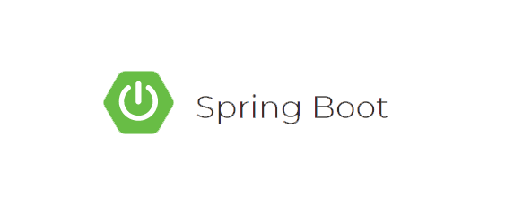
TECHNOLOGIES USED:
Front-End: Angular
Server-side: Spring boot. JPA, Hibernate
Back-end: MYSQL
Web Server: Tomcat

Slide 5


PORTAL
ADMIN
USER

Slide 6
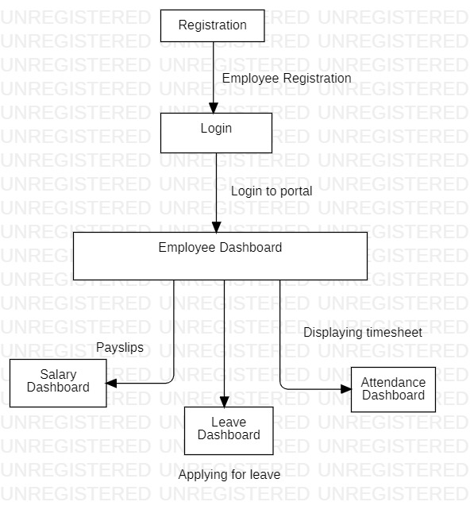
FLOWCHART DIAGRAM FOR USER:

Slide 7
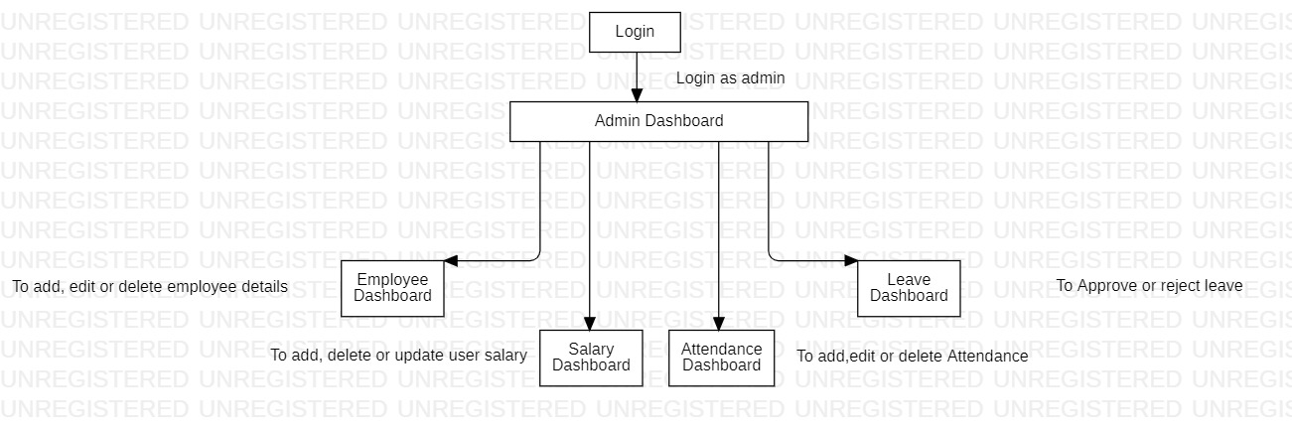
FLOWCHART DIAGRAM FOR ADMIN:

Slide 8
LIST OF MODULES:
User admin Login
User Sign-Up
User Dashboard
User Apply Leave
User Leave Status
User Attendance Dashboard
User Salary Dashboard
Admin Dashboard
Admin-employee Dashboard
Admin Leave Dashboard
Admin Attendance Dashboard
Admin Salary Dashboard

Slide 9
MODULE DESCRIPTION:
Login Module:
The login module enables the employee to login to their portal.
The user need to enter the valid Username and Password and the user needs to choose his/her role for logging in.
If the user login as an admin, it directs to Admin Dashboard.
If the user login as an user, it directs to User Dashboard.
The new user can create their account by clicking on Need Account option.
If user forgets his/her password, they can able to reset their password by using forgot password option.

Slide 10
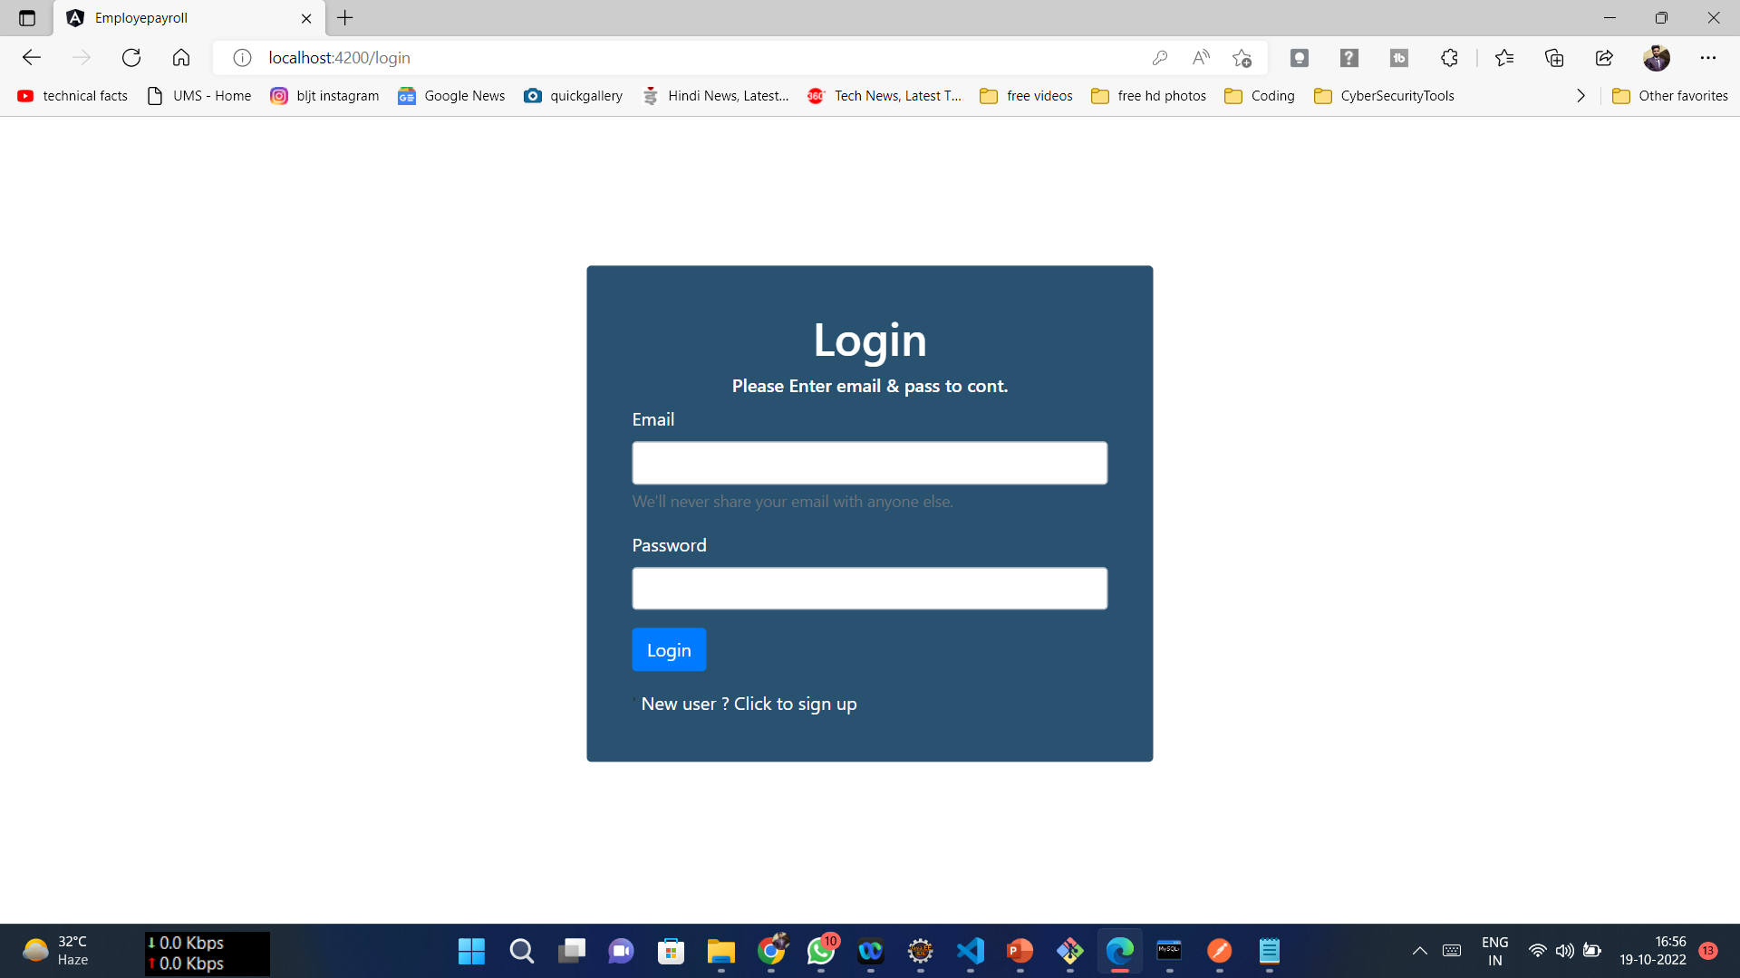
MODULE DESCRIPTION:

Slide 11
MODULE DESCRIPTION:
User Registration Module:
The Employee Registration lets employee to register their details in the company’s portal.
The admin will maintain the registered details for further purposes.
The user will enter details like name, Date of Birth, Gender, Phone Number, Address, email id, Designation, Country, City and Password.
After entering these details, the employee can register their new account.
After successful registration, will receive a popup stating “Employee Added Successfully”.

Slide 12
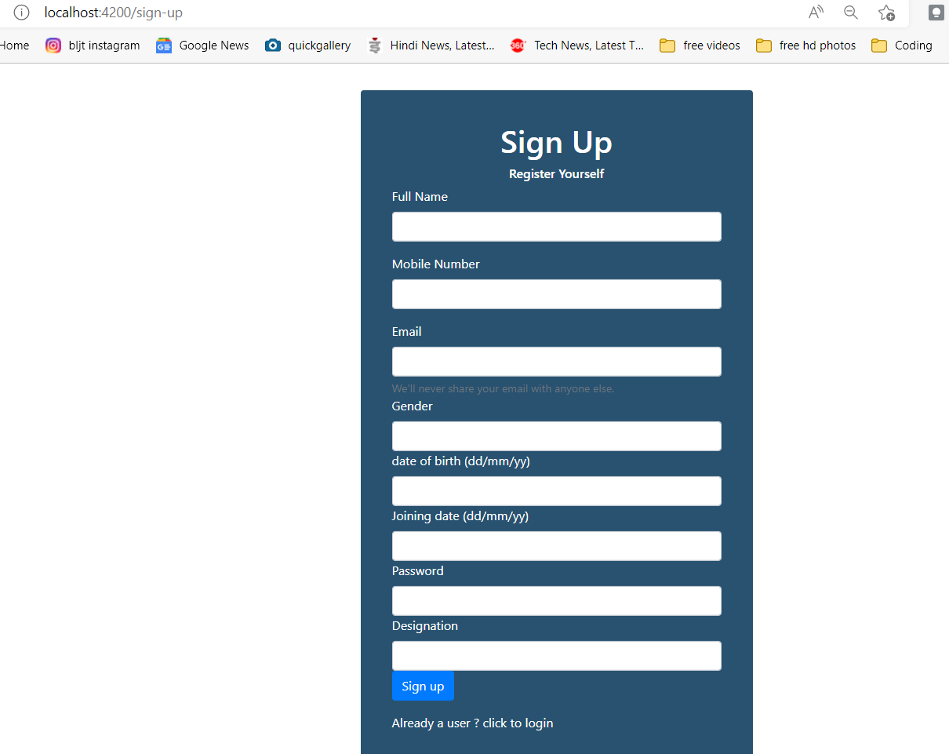
MODULE Screenshot

Slide 13
MODULE DESCRIPTION:
User Dashboard:
After successful login, the user directs to User dashboard.
There will be three drop down menu such as Attendance, Leave and Salary through which the user can navigate to the respective pages.
The user can edit their details by using edit option and the details will be updated.
The user could edit any details like name, mobile, password, designation and so on.
And also the user can logout from this dashboard by just clicking the logout option.

Slide 14
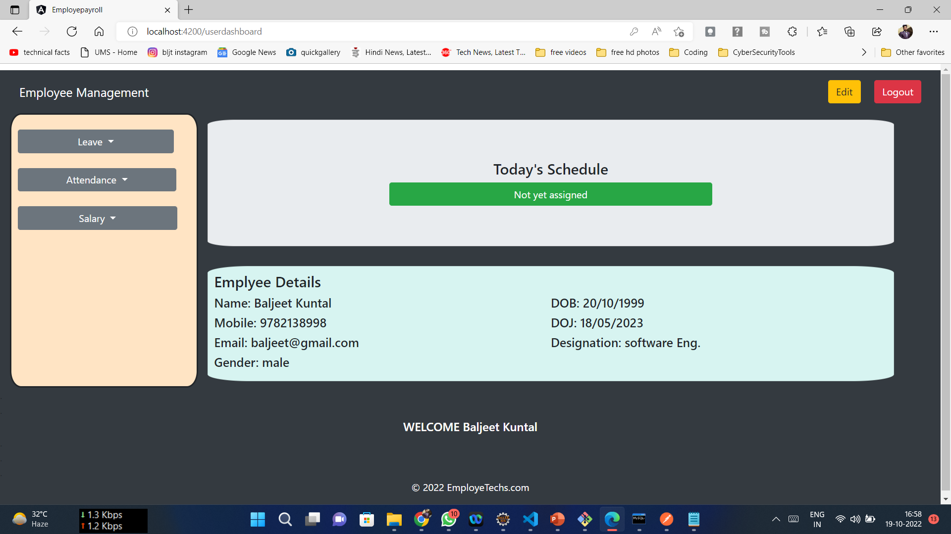
MODULE Screenshot:

Slide 15
MODULE DESCRIPTION:
User Salary Module:
From the User Dashboard, the user can navigate to Salary Dashboard to view the details of Salary.
The Salary details like Name, Month, Year and salary are displayed in this page.
Here the user cannot edit any details. Only the admin can do changes in this module.
The User can able to download their Payslips through this module.
And save in their system for their references.

Slide 16
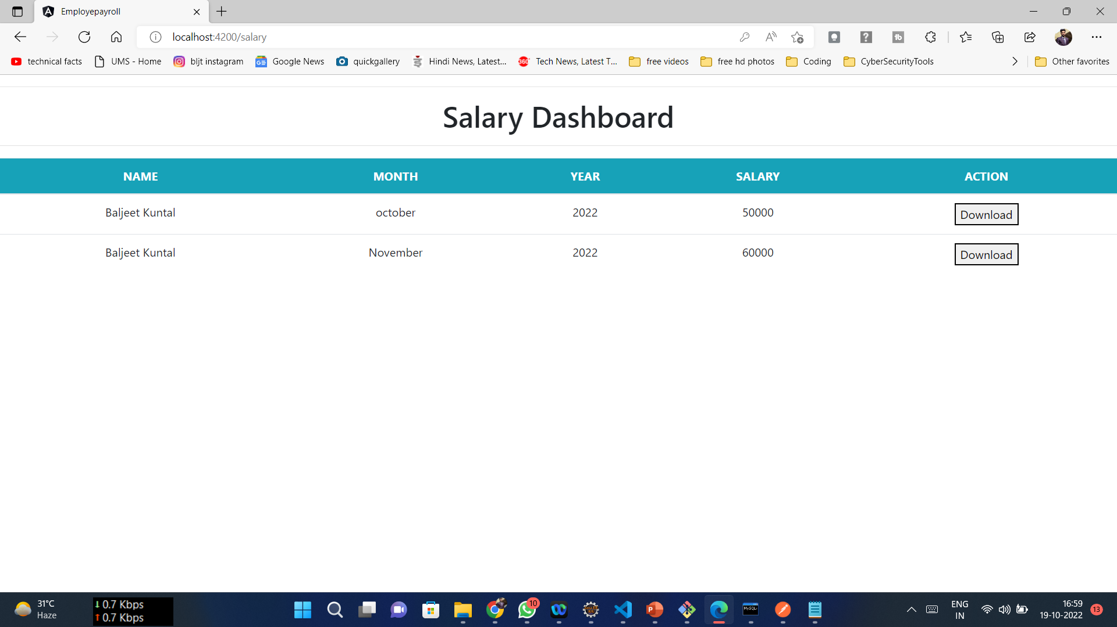
MODULE DESCRIPTION:

Slide 17
MODULE DESCRIPTION:
User Leave Dashboard:
The user can apply for leave through this Dashboard by entering the start date, end date and reason.
After applying the user can check for their status in the leave status page.
The details like employee id and status will be displayed in that page.
Once the admin approves the leave of an employee, it shows the status “Approved”.
If the request is pending, it shows status like “Pending”.

Slide 18
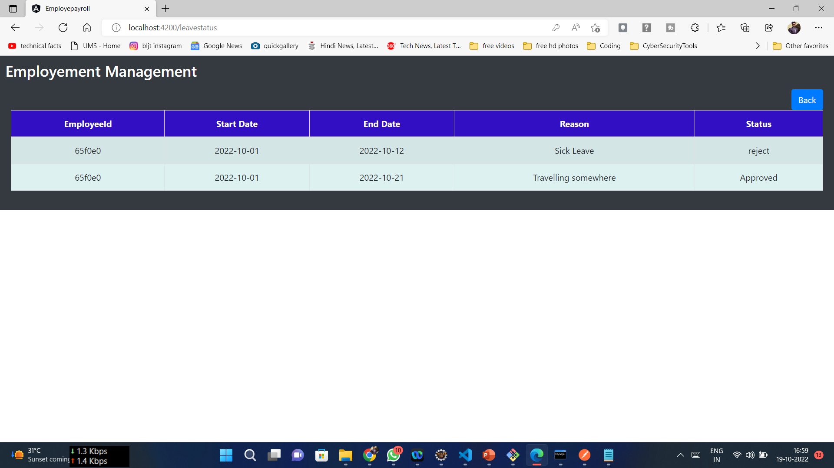
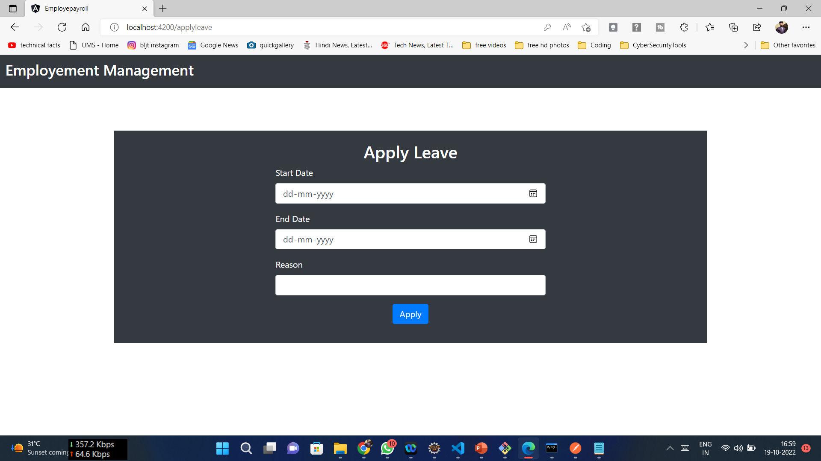
MODULE DESCRIPTION:

Slide 19
MODULE DESCRIPTION:
User Attendance Dashboard:
The User Attendance Dashboard provides the attendance details for an user.
The User can use this dashboard for starting their day of work by entering some data like their id, start time, end time and so on.
They can also update any data by using update option in any case like changes in end time or wrong credentials.
The Attendance Dashboard helps the admin to track their daily basis of work for salary purposes and number of leaves.

Slide 20
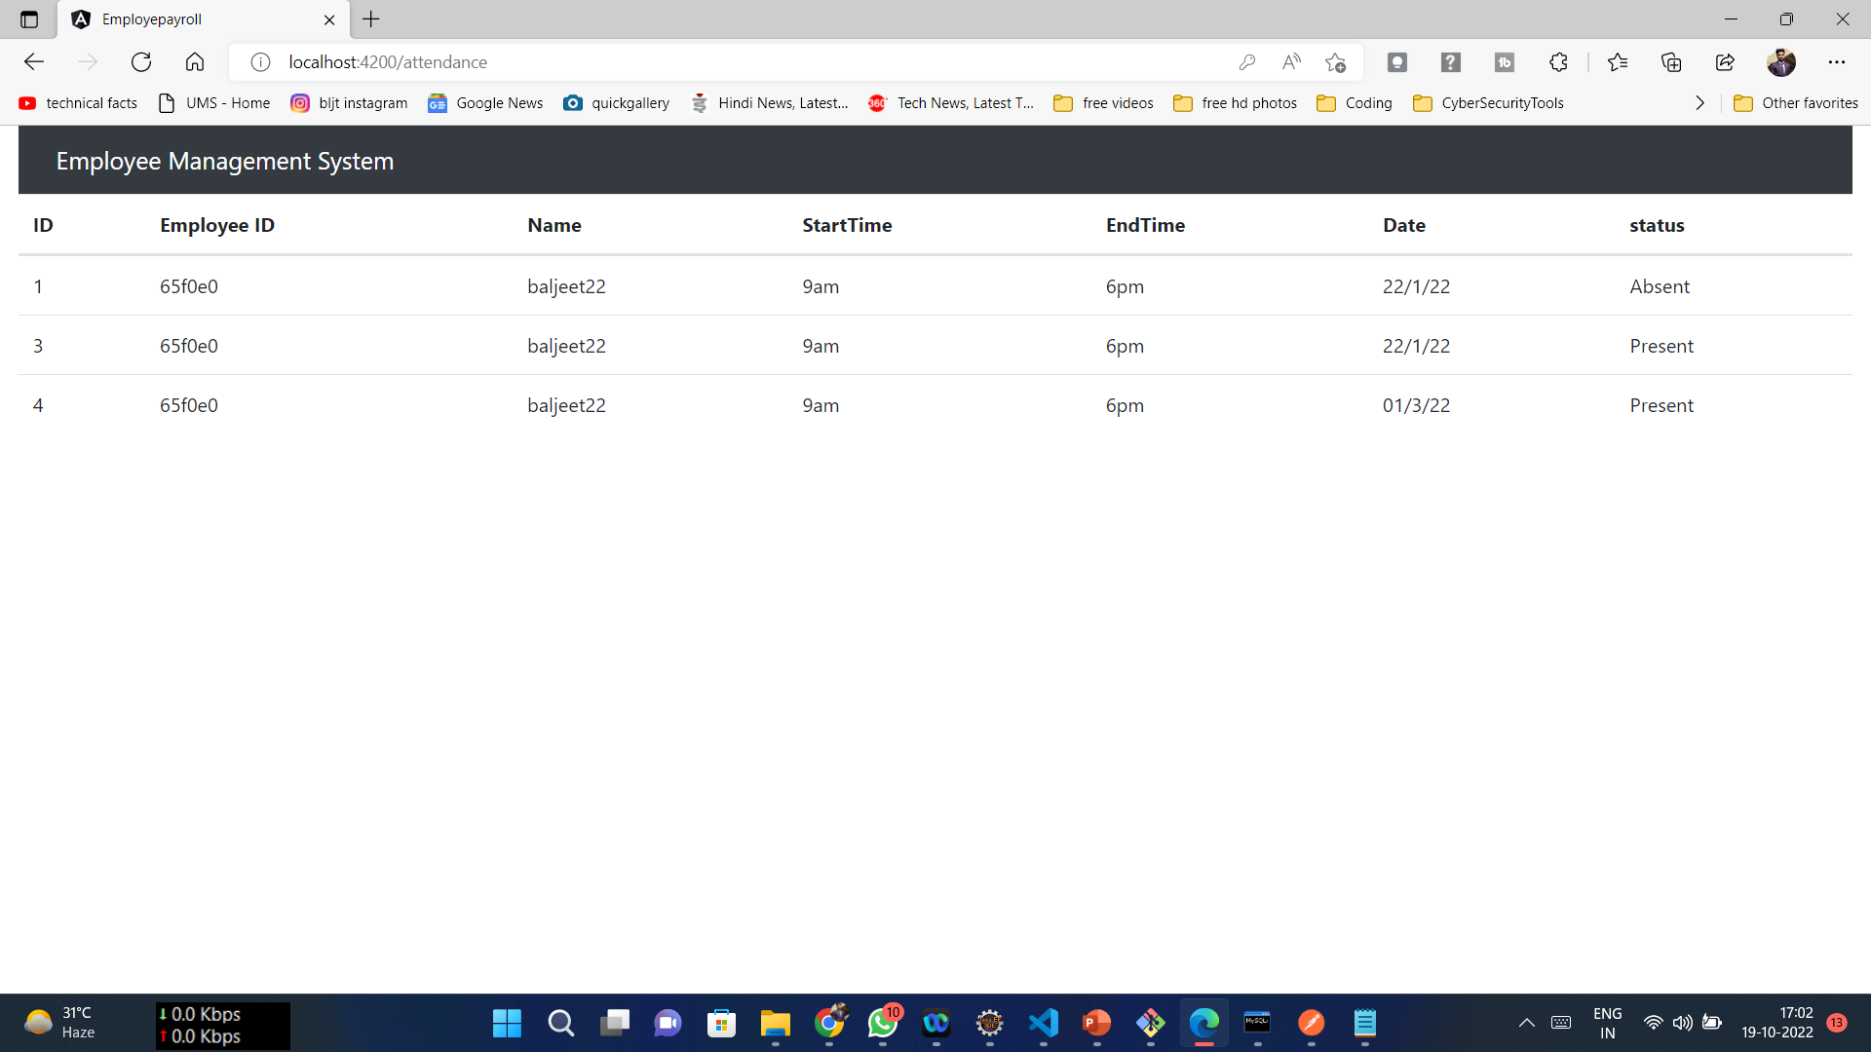
MODULE Screenshot

Slide 21
MODULE DESCRIPTION:
Admin Employee Dashboard:
The Admin Employee Dashboard is handled by admin for adding, deleting and editing the employee details.
The Admin can navigate to Employee, Salary, Leave and Attendance dashboard for the user’s data.
If the Admin causes any changes to the data of a employee, it reflects on the User Side also.
Adding new employee will ask some details like Empid, Name, Mobile, Email, Gender, Date of Birth, Date of joining, Password, Designation, Role and Schedule.

Slide 22
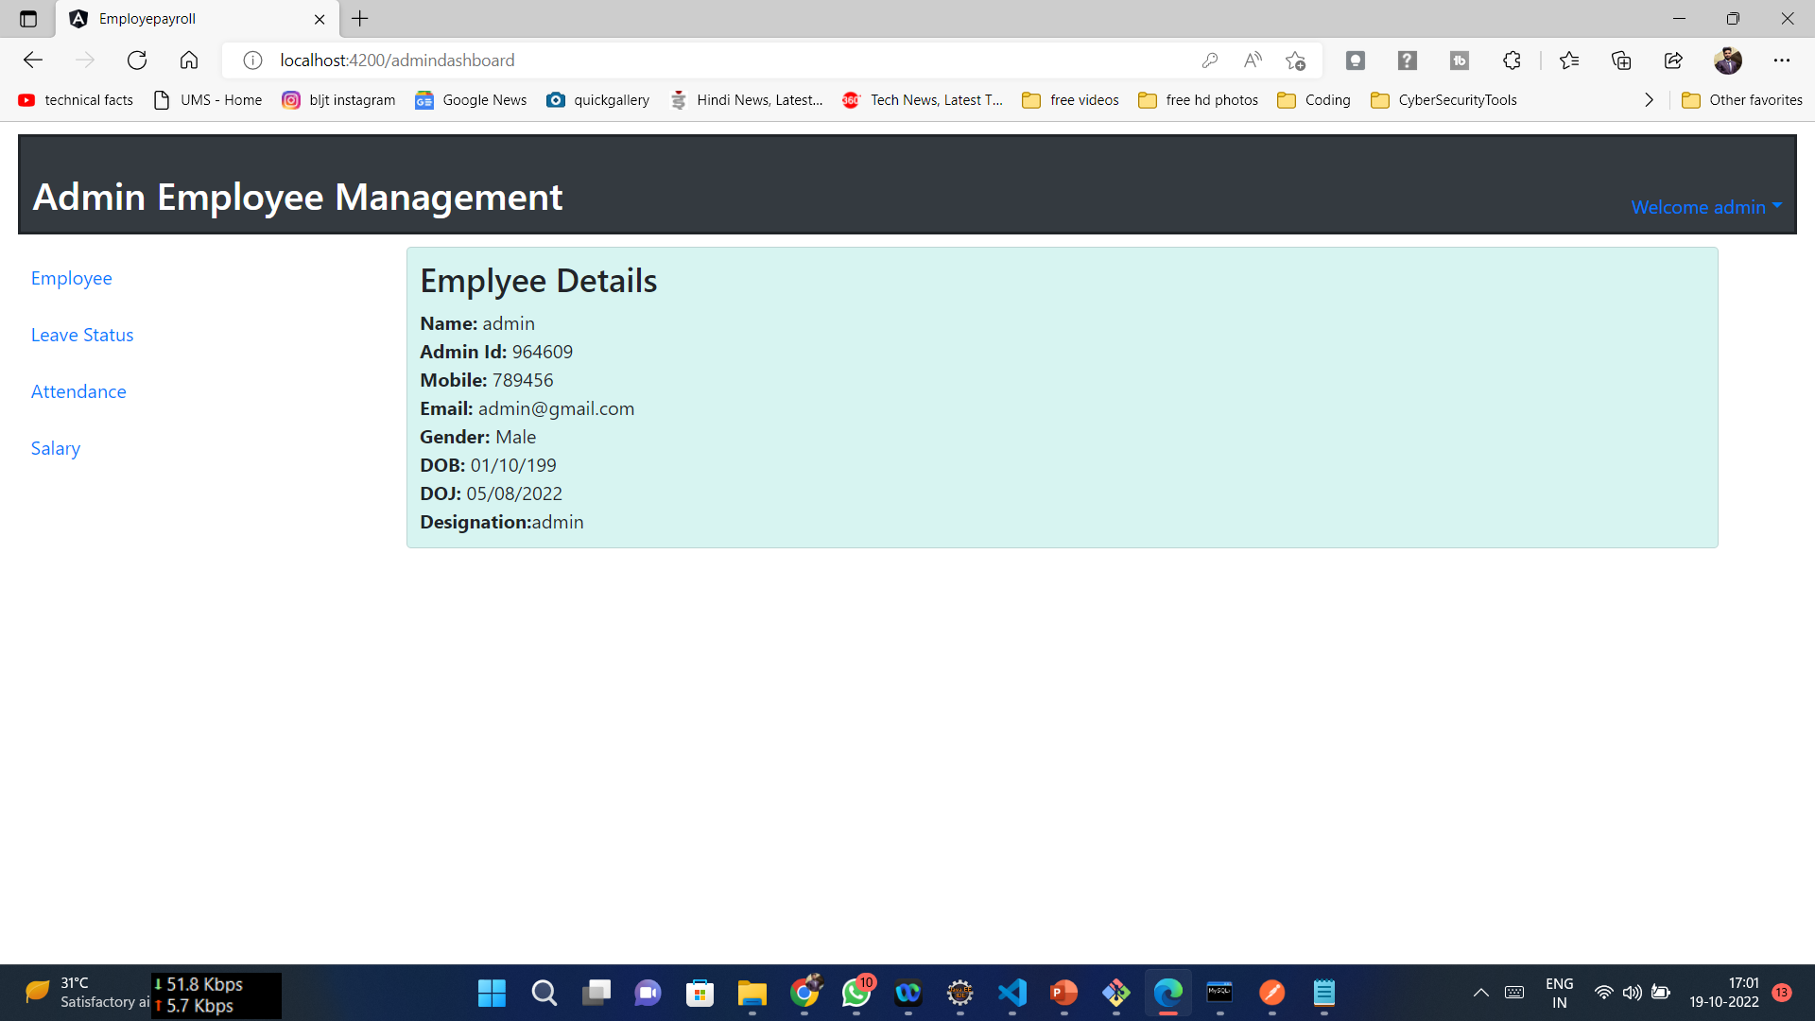
MODULE Screeshots:

Slide 23
MODULE DESCRIPTION:
Admin Salary Module:
The admin can login to the portal with their login credentials and navigate to the salary module.
The admin can add data of a new employee like employee id, Name, Month, Year, Salary and save the details.
There is an update option where the admin can update the salary of an employee which will be reflected in User Salary Dashboard.
The admin can edit or delete any data by using edit and delete options.

Slide 24
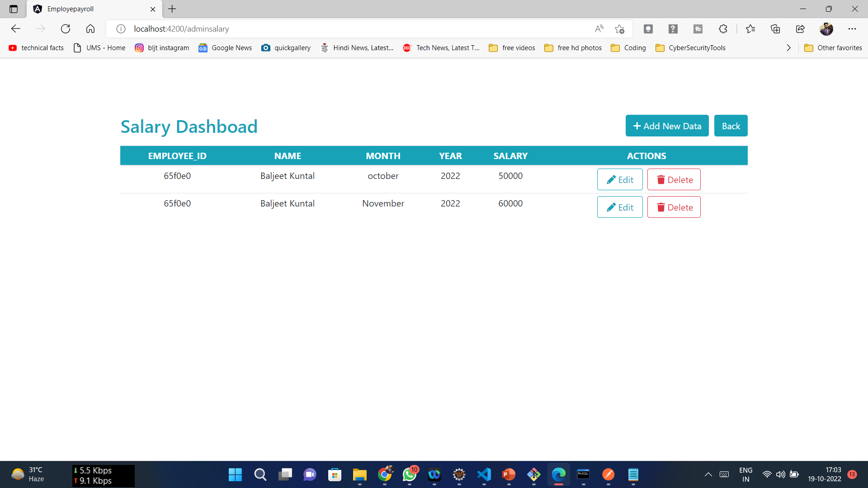
MODULE Screenshots:

Slide 25
MODULE DESCRIPTION:
Admin Leave Dashboard:
The Admin can navigate to the leave status dashboard for checking the employee’s leave application.
There are two functionalities such as Pending and Remaining.
In Pending tab, the newly applied leave is shown and waits for the action of admin like Approve or Reject.
In Remaining Tab, the records of already approved or rejected leaves of the employees are displayed.
This makes sure that employee cannot extend their leave without any knowledge of the admin .

Slide 26
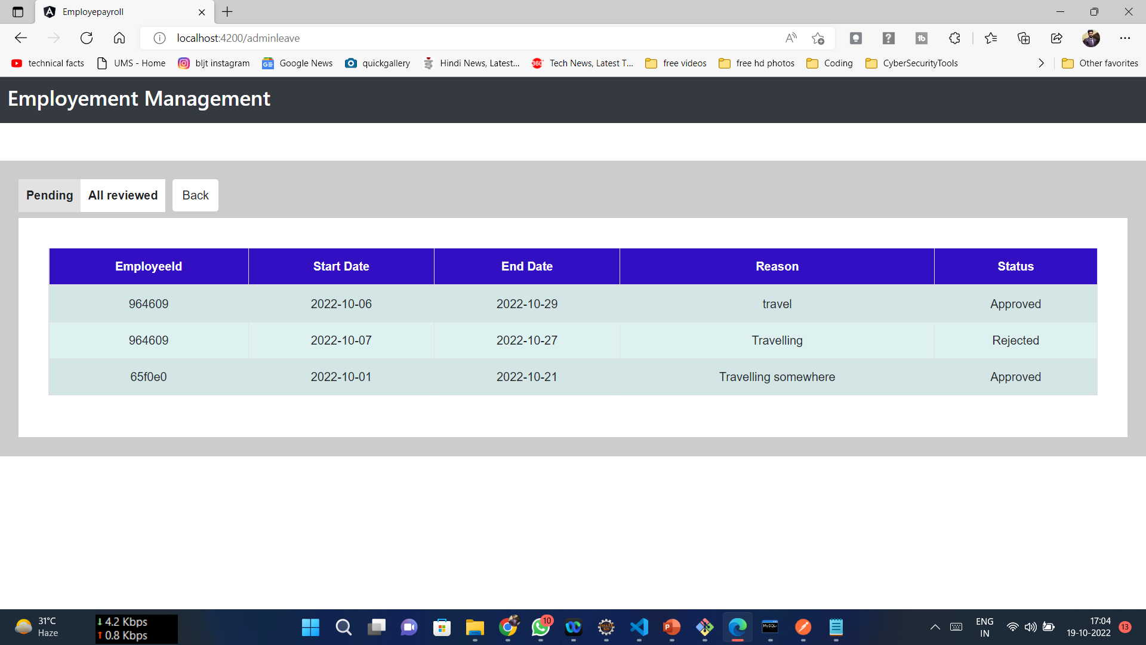
MODULE Screenshots:

Slide 27
MODULE DESCRIPTION:
Admin Attendance Module:
The Admin can view the attendance of employee from start time of login and end time of their work.
Admin can edit and delete the attendance of an user if any changes in their timings.
They can also add attendance of an employee by entering their Employee id, Name, Start time, End time, Date and Status.
Also admin can update any details regarding the attendance of an employee in this dashboard.

Slide 28
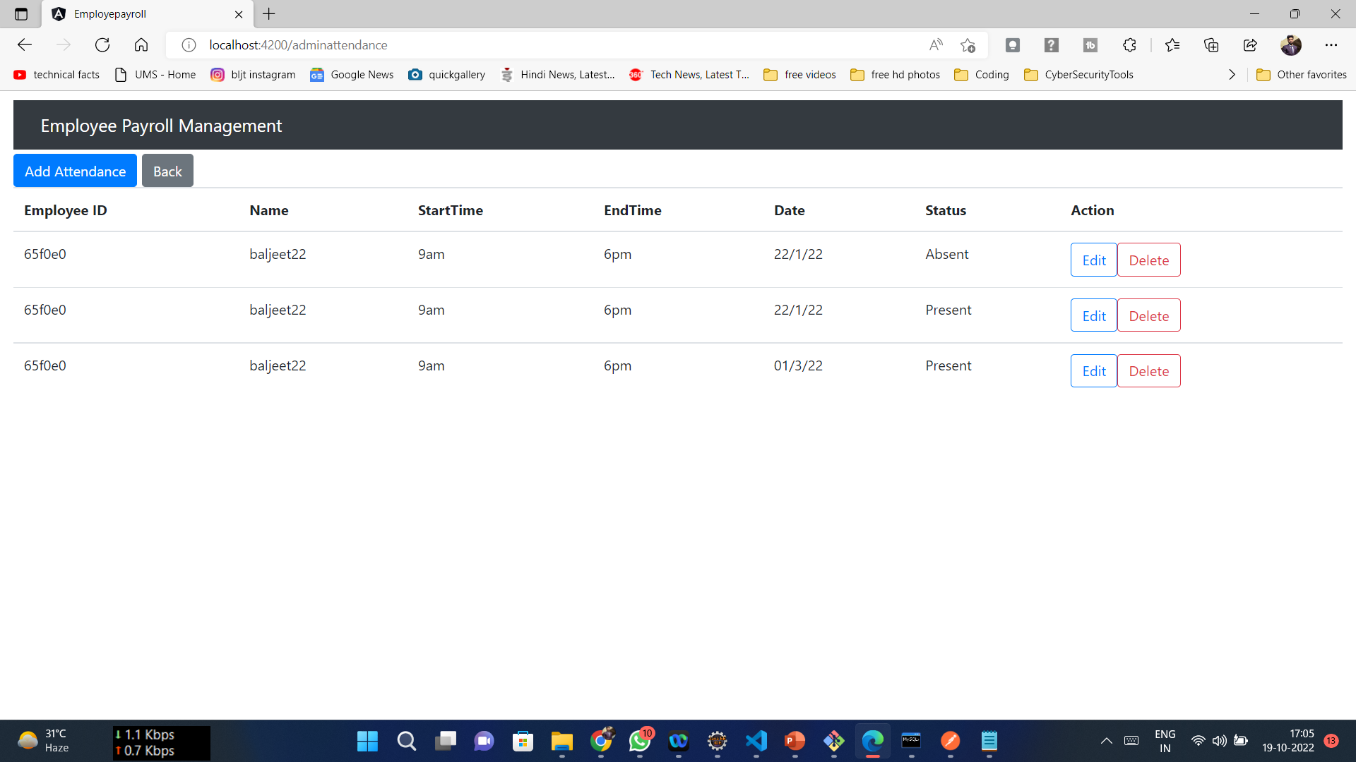
MODULE Screenshots:

Slide 29
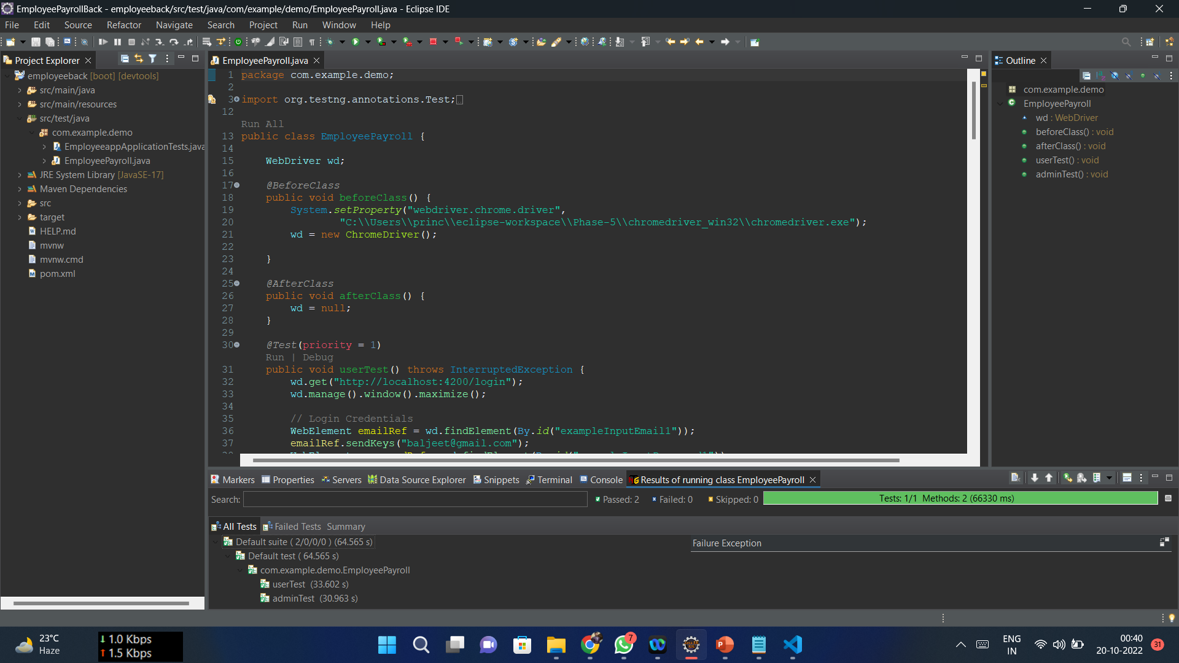
Testing :

Slide 30
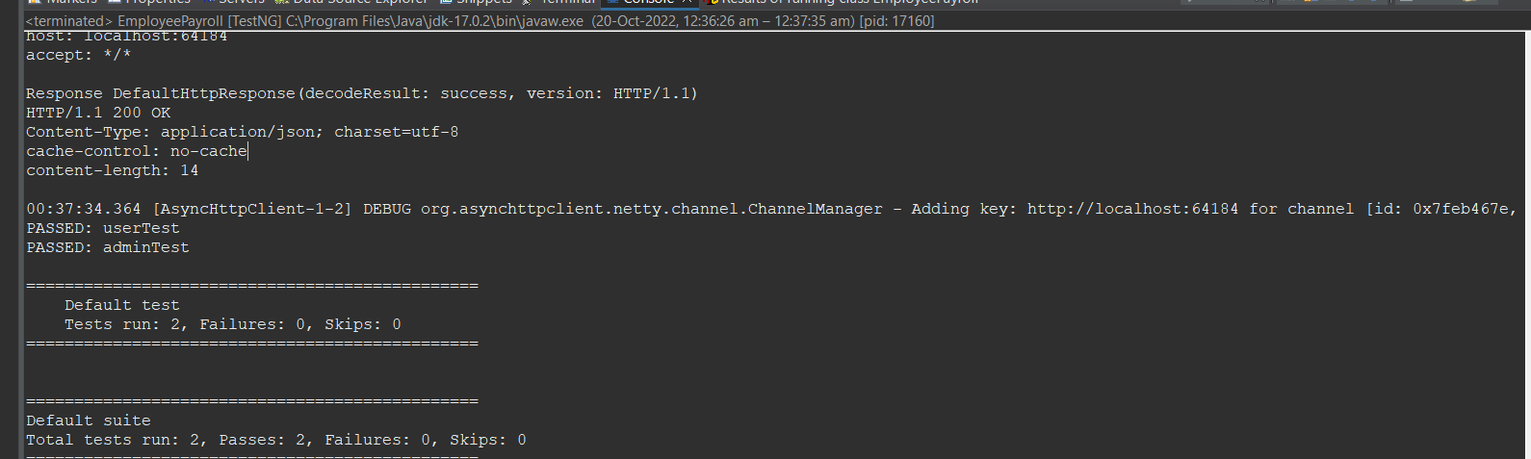
Testing :

Slide 31
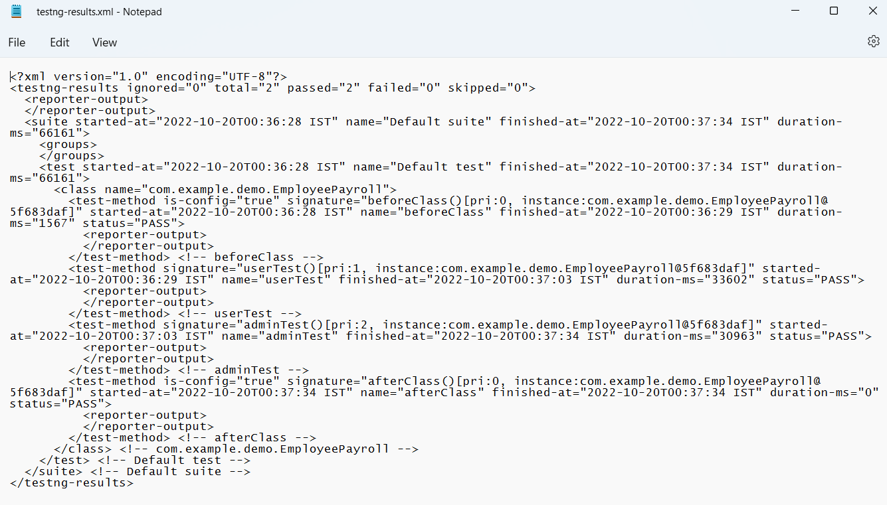
Testing :

Slide 32
CONCLUSION:
Payroll Management System is developed for a company has been designed to achieve maximum efficiency and reduce the time taken to handle the payroll activity.
It is designed to replace an existing manual record system thereby reducing time taken for calculations and for storing data.
It makes us easier for searching any records of employees by using their employee id in short period of time.
As this process is automated , it is easier for admins to store lots of information of each employee in a simple manner.
This kind of managing system also ensures the safety of employees data.

